Slide 1
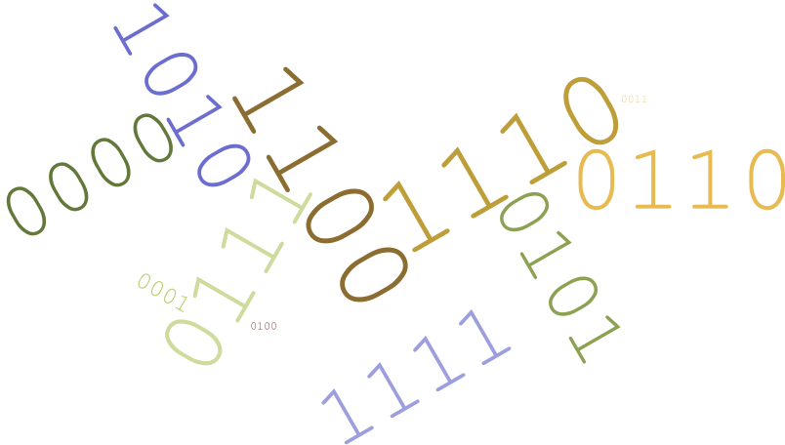



Disassembler
Benjamin Lin | Hamza Siddiqui Keziah May | Maxwell Wenger

Slide 2
Disassembler
DREAMTEAM.L
Benjamin Lin | Hamza Siddiqui Keziah May | Maxwell Wenger

Slide 3




Overview
IO
OPCODES
EA
Integration
Issues/Simulator Bugs
Conclusions

Slide 4
Input/Output
Comprehensive list of items completed and items to do.

Slide 5
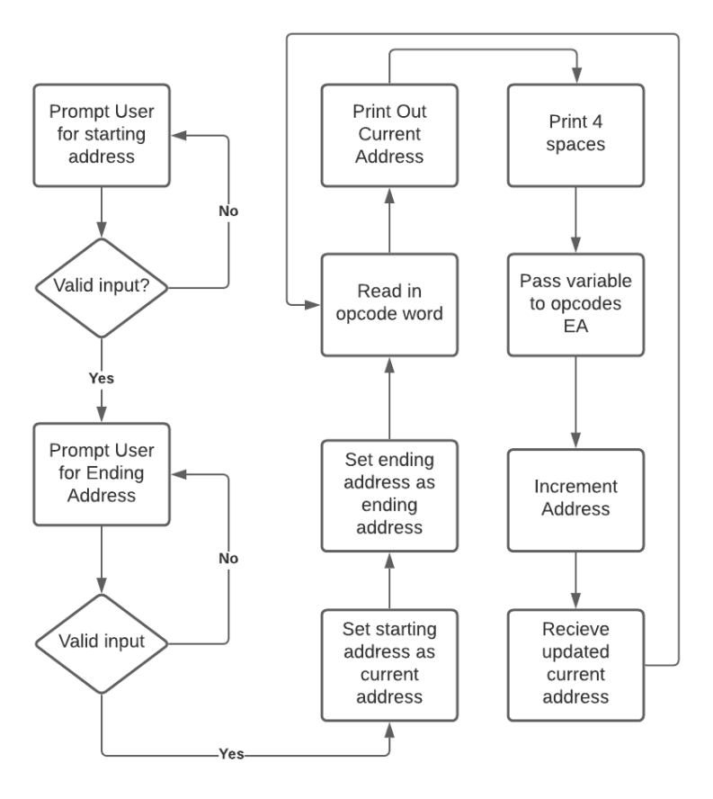
I/O

Slide 6

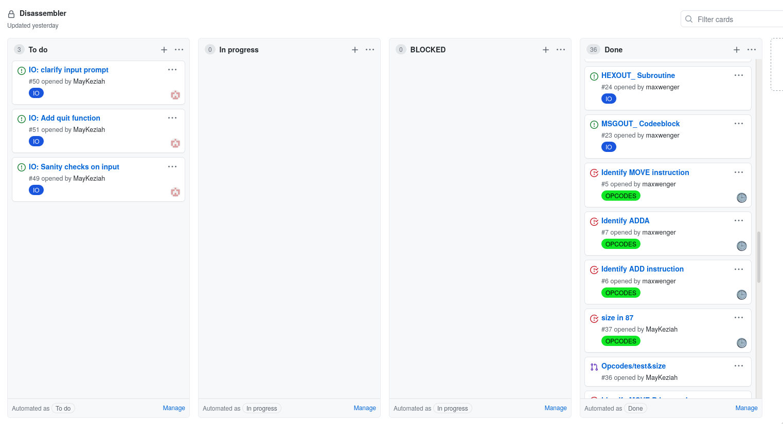
I/O

Slide 7
I/O
Done
1. Prompt for start address
2. Prompt for end address
3. Read instruction in memory to register
4. Display current address and tab
5. Call OPCODE module
6. Increment address pointer
7. Loop through memory to end address
8. Loop prompt for input

Slide 8
OPCODES
Comprehensive list of items completed.

Slide 9
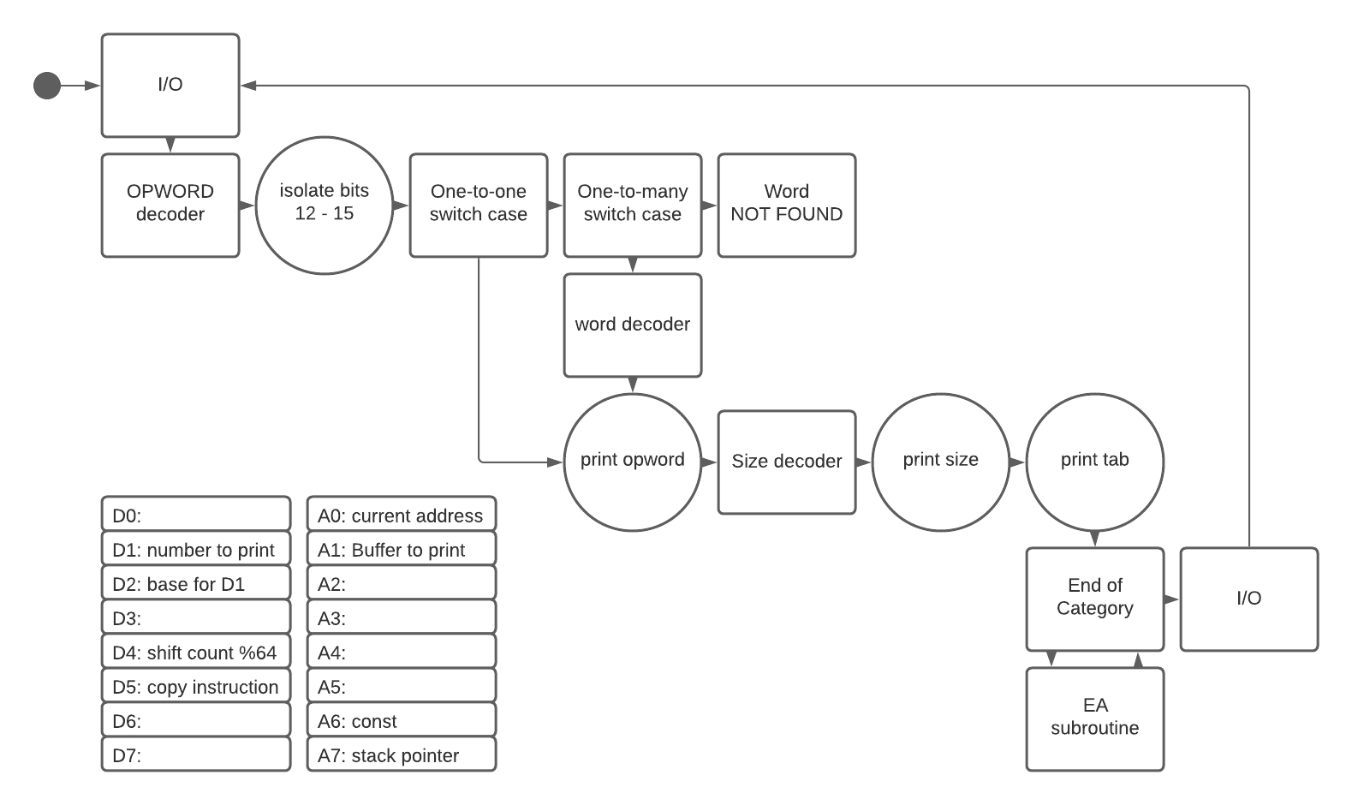
OPCODES

Slide 10
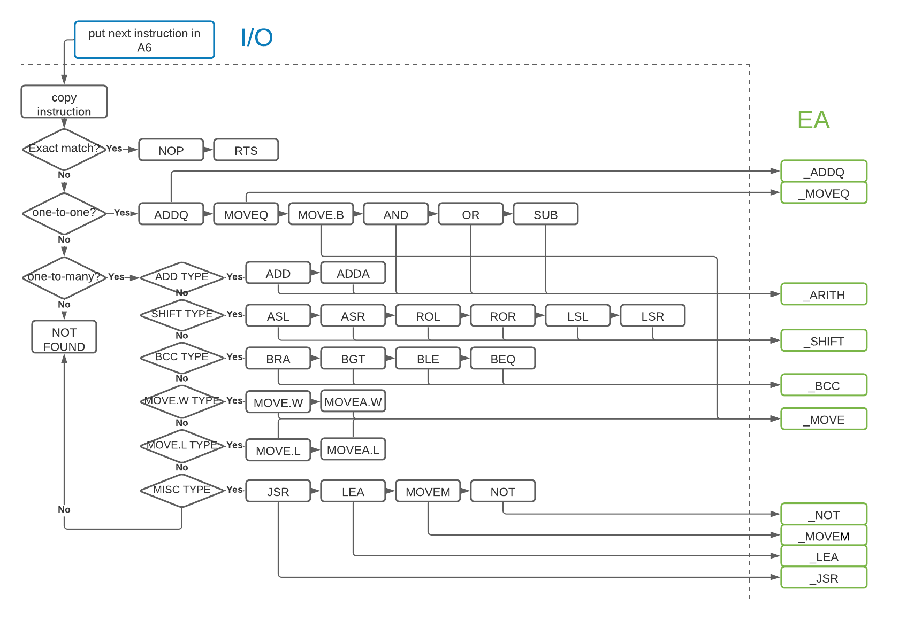
OPCODES

Slide 11
OPCODES
Done: decode & display opword, size, and tab
Exact Match
RTS
NOP
One to One
ADDQ
AND
OR
SUB
MOVEQ
MOVE.B
One to Many
ADD, ADDA
ASL, ASR, LSL, LSR, ROL, ROR
Bcc (BGT, BLE, BEQ), BRA
JSR, LEA, MOVEM, NOT
MOVE.W, MOVEA.W
MOVE.L, MOVEA.L

Slide 12
EA
Comprehensive list of items completed.

Slide 13
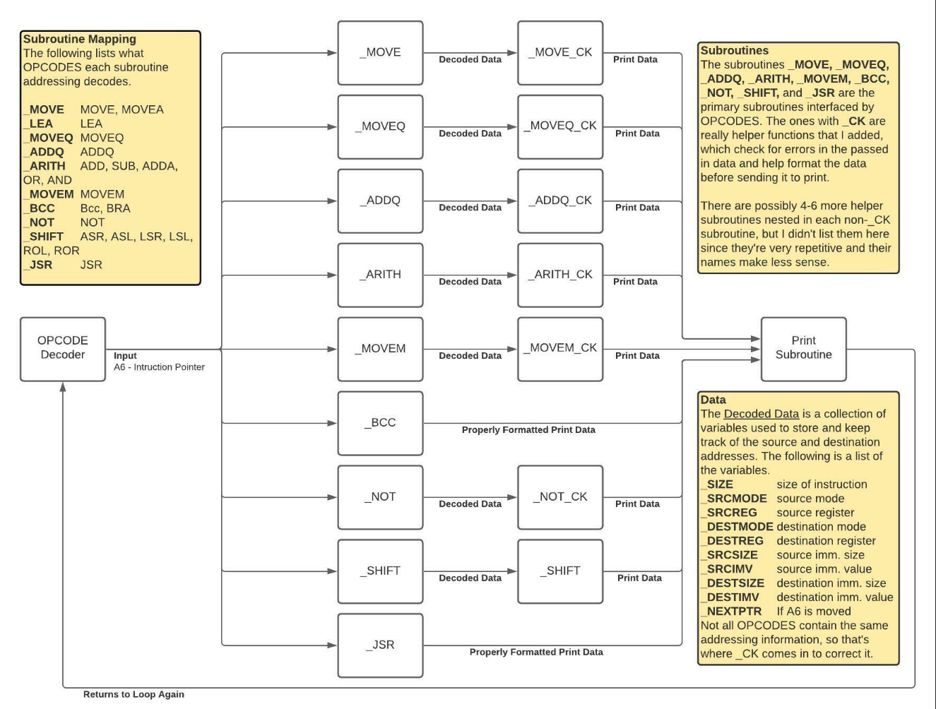
EA

Slide 14
EA
Done
1. Implement provided interface subroutines for OPCODES
2. Create error handling for each subroutine
3. Create printing function for each subroutine
4. Decode all required Effective Addressing Modes: Data Register Direct Address Register Direct Address Register Indirect Immediate Data Address Register Indirect with Post incrementing Address Register Indirect with Pre decrementing Absolute Long Address Absolute Word Address

Slide 15
Integration
Comprehensive list of items completed.

Slide 16
Integration
I/O
OPCODES
EA

Slide 17

Integration
I/O
OPCODES
EA
NEXT_ Instruction in A6
_OPWORD_ Instruction in A6
_*_ Instruction in A6
_* Instruction in A6
NEXT_ Instruction in A6
_EOP_ Instruction in A6
_*_ Instruction in A6
_* Instruction in A6

Slide 18
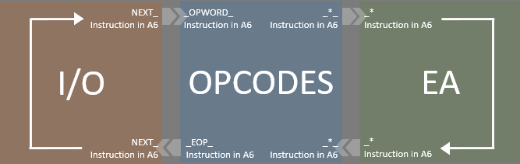
Integration
IO/OPCODE Interface
IO Required | OPCODE Provided
NEXT_ | _OPWORD_
OPCODE/EA Interface: All return
OPCODE Required | EA Provided
_EMOVE_ | _MOVE
_LEA_ | _LEA
_MOVEQ_ | _MOVEQ
_RTEOPAQ_ | _ADDQ
_RTEOP8_ | _ARITH
_EMOVEM_ | _MOVEM
_EBCC_ | _BCC
_ENOT_ | _NOT
_EOFSHIFT_ | _SHIFT
_JSR_ | _JSR
OPCODE/IO Interface
OPCODE Required | IO Provided
_EOP_ | NEXT_

Slide 19
Issues
What we struggled with and how we responded.

Slide 20
Issues
Along the way, these concepts slowed us down:
Remembering to clear registers
Incrementing/decrementing the memory pointer
Integration miscommunication
Naming conventions
Planning register usage
Agreeing on which function does what
Handling errors
Standardizing error handling
Using wrong size
Tracking test cases before integration

Slide 21
Issues
Error Handling Display Standards:
OPCODES Invalid OPCODE: XXXX DATA YYYY ^ ^ ^ Memory Error Hex instruction unable to decode address Display located at XXXX in Memory Invalid size: XXXX ADDQ.X OP1,OP2 ^ ^ ^ Memory Error EA’s display for address size this instruction display
EA Invalid operand 1A00 MOVE.W <invalid EA mode>, D1 1A02 MOVE.L (A4)+, <invalid EA mode> 1A02 MOVE.B <invalid EA mode>, <invalid EA mode>

Slide 22
Issues
Error Handling Display Standards:
OPCODES Invalid OPCODE: XXXX DATA YYYY ^ ^ ^ Memory Error Hex instruction unable to decode address Display located at XXXX in Memory Invalid size: XXXX ADDQ.X OP1,OP2 ^ ^ ^ Memory Error EA’s display for address size this instruction display
EA Invalid operand 1A00 MOVE.W <invalid EA mode>, D1 1A02 MOVE.L (A4)+, <invalid EA mode> 1A02 MOVE.B <invalid EA mode>, <invalid EA mode>
Not all opcodes follow this pattern. Some one-to-many result in an invalid opword instead of an invalid size.

Slide 23
Conclusions
Advice for future CSS432 students.

Slide 24
Conclusions
Start early
Plan interfaces and naming conventions
Dedicate registers to specific tasks
Create a list of test cases for each OPCODE and EA
Find patterns to categorize OPCODES and EA
Test and Commit to your branch often
Meet often to confirm your integration plans
Integrate early
Do extensive integration testing
Test error handling cases
Try not to cry

